Slide 1
MS&E 273
Building Financial Models
Mike Lyons
Jack Fuchs

Slide 2
Agenda for Today
Gate I: Some General Feedback to the Teams
Gate II: Considerations for CEO and CFO
Financial Modeling in Entreprenership
Proxies and How They Can Inform Your Thinking
Guest Speakers – Mike Kourey, Kosla Ventures; Peter Kent – Financial Expert

Slide 3
Opportunity Assessment: Gate I
You have about 5 minutes to get VCs attention
Product needs to meet market – hand-in-glove
Achieve deep knowledge about your market and customer
Your words matter – ask yourself, “What do I want the investors to take away from this slide?”
Slides should complement the presentation
How do I respond to questions?
How do we become a team?
Focus for next 7 weeks on what’s important to YOUR business – execution and investigation

Slide 4
The Gate I “Effect”
Now You Appreciate the Difficulty
Don’t Be Discouraged!; You Need to Develop a Thick Skin
It’s Not Personal
You Only Had 3½ Weeks
Critical Feedback Now Avoids Train Wrecks at the End
We Will Coach You Throughout the Process
Don’t Be Afraid to Ask for Help!

Slide 5
Why Do A Financial Plan?
Need to Create and Validate Business Models
Prove that Your Business Is Not Just An Expensive Hobby
Test Your Business Model and How it Scales
Understand the Drivers and Important Assumptions for Your Business
Understand the Cash Requirements, Especially As the Business Scales
Tells You What the Most Important Assumptions Are

Slide 6
Required Reading and Tools
All Should Have Reviewed Website Resources://www.stanford.edu/class/msande273/resources.html
Financial Models: All Should Have Watched:
Peter Kent’s Financial Primer: Slides with Embedded Video
Jeff Kuhn’s Income Statement/Balance Sheet Discussion at: http://www.stanford.edu/class/msande273/video/financial.html
CFOs Have Download the Peter Kent/Insight Business Tools Model – Questions for Peter?
Optional but excellent: Randy Komisar’s Getting to Plan B

Slide 7
Basic Steps to Building the Model
We Will Now Go Through Each Step in Detail

Slide 8
3 Principle Financial Statements
Your Business Model
Income Statement
Balance Sheet
Statement of Cash Flows
Amount of profits, etc. earned during a period
Amount of assets, etc at a POINT IN TIME
Amount of cash generated (burned) during a period

Slide 9
Preparation for Financial Statement Development
Business Model
Financial Statements
Forecasts and Operating Plan
Milestones

Slide 10
Scalable Business Model
Business Model
What is your business?
Where does the money flow?
Unit Economics
What is the relevant “unit”?
Fixed and variable?
Scalability
What is lifetime value of Customer?
What is are the costs and revenue associated with that unit?
Customer acquisition costs?
What cost, revenue, customer acquisition assumptions change and why?
How do you plan to bring the product to market?
Lifetime value of a customer?
How can you validate those assumptions?
How does the product move?
What is your revenue model?
How do economics change (improve) over time?
Examples: SaaS, Enterprise Sales, Marketing-Driven, Inside Sales, Distribution, Consumer Internet, Retail

Slide 11
Let’s Build a Business Model
What do you sell?
To whom do you sell it?
What is a typical transaction?
Purchase, subscription?
How much?
How does money change hands?
Who is your customer?
How does product flow?
How will you go to market?
Who else is involved (distributor, advertiser)?

Slide 12







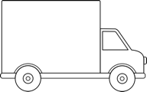
Example Business Model
Agricultural industry
Solid waste
$
Fertilizer
monthly
subscription fee
$
$
Waste Collection Service Companies
End user
+
use of
toilets
waste collection service
sale of toilets
10
Notes:
Change title to Business Model
Product and cash flow
reverse arrows showing money flow:
add truck
ok redo the visual of toilet

Slide 13
Unit Economics: Building Blocks of Business Models
What is a relevant unit?
1 sale
1 customer
1 user
1 advertiser
1 blogger
1 sales rep
1 market
Price and quantity – How to determine price
Cost of goods sold – BOM (What’s in COGS?)
Customer acquisition cost
Purchase patterns

Slide 14
Preparation for Financial Statement Development
Business Model
Financial Statements
Forecasts and Operating Plan
Milestones

Slide 15
We’ve Got Business Model Figured Out; Now Let’s Agree on the Milestones
Create a Gantt Chart That Lays Out Key Milestones: (Heavily Influenced by Type of Company)
Product Development Timelines
Market Timelines
Company Timelines
IP and Regulatory Timelines, if any

Slide 16
Example: How We Get There: Milestones
2013
2014
2015
2016
M1
M2
M3
M4
M5
M6
M7
M8
M9
M10
M11
M12
M1
M2
M3
M4
M5
M6
M7
M8
M9
M10
M11
M12
Initialize
Develop
Launch
Expand
Proof of Concept
Miniaturized Prototype
Beta Prototype
Marketable Product
Second Release
New Products
Product
Market
San Jose
Bay Area
5 Metro Areas
Asia / Europe
Company
Build Development Team
Begin Manufacturing
US Sales Force
Global Sales Force
Notes:
16

Slide 17
Preparation for Financial Statement Development
Business Model
Forecasts and Operating Plan
Financial Statements
Milestones

Slide 18
Let’s Do the Revenue Plan – Forecast
Create A Pro-Forma Sales Forecast Driven by Product Readiness
Do It Bottom Up w/Identified Customers for 2-3 Years
Match This to a Top Down Forecast In Out-Years (4 and 5)
Use Proxy’s to Guide You
You Must Understand the Numbers

Slide 19
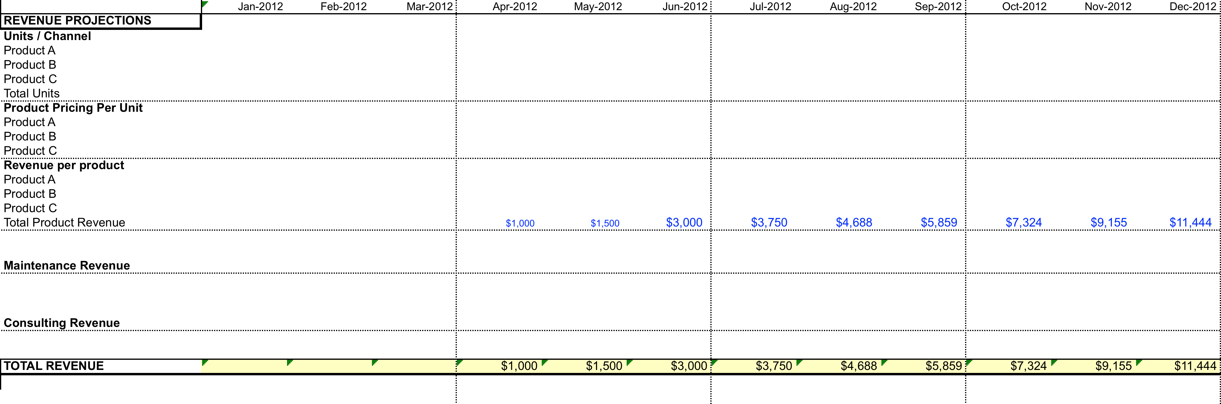
From the Peter Kent Revenue Tab:

Slide 20
Cost of Goods Sold (COGS)
Elements of COGS
Bill of Materials (BOM)
Other manufacturing and supply chain costs, including overhead (or more likely price from a contract manufacturer)
For IT businesses: costs associated with serving that customer – mostly variable or incremental, Including Royalties for licensed software, if any
COGS varies with stage of business – can be substandard in early year(s)
At maturity, reasonable COGS values vary by type of business, though >50% is important
Understand how COGS is affected by distributors and other partners

Slide 21
We’ve Got Revenue and COGS Figured Out; Now Let’s Build the Whole Company Model
Develop a Headcount Plan That Supports The Milestones
Operating Stacks Are Driven Heavily by Headcount
G&A, Operations, Marketing, Product Development (R&D)
Proxy Companies Can Be Helpful Here
Revenue Does Not Come Without Significant Costs
The Biggest Errors in Financial Modeling Usually Involve Ignoring the Significant Go to Market and Product Development & Support Costs

Slide 22
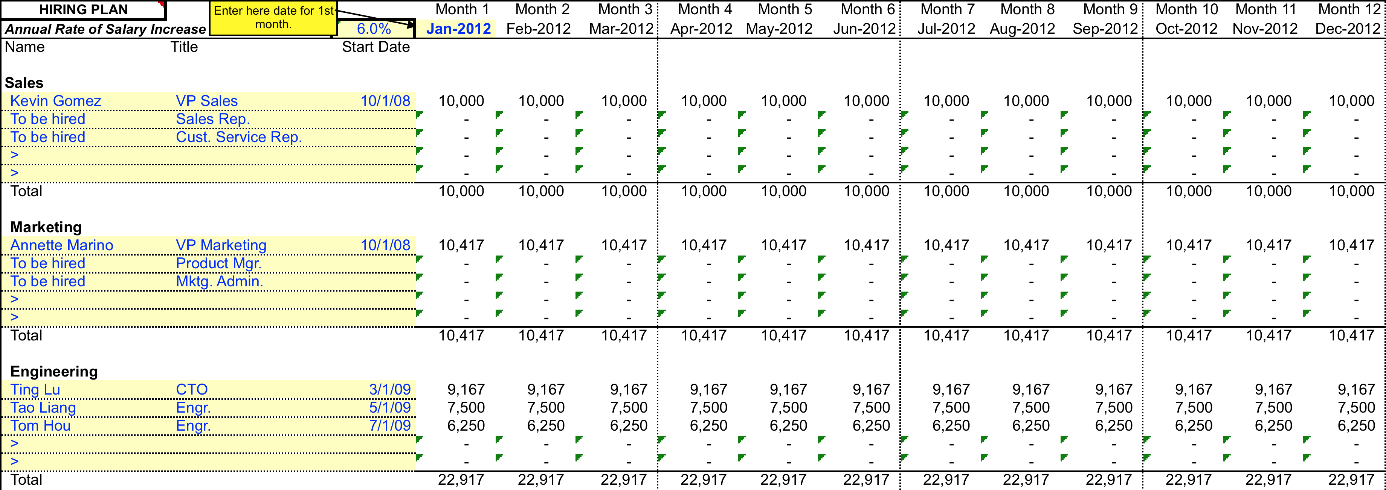
Headcount for Operating Plan – Kent Model
Expenses Tab Captures Costs Associated with Supporting This Headcount

Slide 23
Operating Costs – Bottom-up and Top-Down
Built up from detailed assumptions for first 2 – 3 years
Then % of revenue in for years 4 and 5 (proxies)
In what ways do (and don’t) we look like a typical ____ company?

Slide 24
Operating Stack - Example (OPEX)
Year 2013 2014 2015 2016 2017 2018 2019
Employees 11 18 24 32 43

Slide 25
Preparation for Financial Statement Development
Business Model
Forecasts and Operating Plan
Financial Statements
Milestones

Slide 26
Financial Projections
Millions
$70.9
Breakeven in 14 Months
Revenues
Net Cash Flow
Main Drivers | Year 1 | Year 2 | Year 3 | Year 4 | Year 5
# of Units Sold / Year | 2,000 | 4,200 | 6,800 | 10,200 | 14,280
Enterprise Customers | 1 | 6 | 18 | 48 | 122
Gross Margin | - | 41% | 63% | 72% | 74%
26

Slide 27
3 Principle Financial Statements
Your Business Model
Income Statement
Balance Sheet
Statement of Cash Flows
Amount of profits, etc. earned during a period
Amount of assets, etc at a POINT IN TIME
Amount of cash generated (burned) during a period

Slide 28
Income Statement – Kent Model
 | Year 1
 | FY 2013
INCOME STATEMENT | Actual
Revenue | 100 | Business Model, Revenue Model
Cost of Revenue | 40 | BOM, Supply Chain, Hosting
Gross Profit | 60
Gross Margin | 60%
OPERATING EXPENSES
Sales | 100 | Selling Model and Customer Acquisition Cost
Marketing | 150 | Customer Acquisition Cost, Brand
Engineering | 300 | Milestones, Headcount
Operations | -
General & Admin. | 30 | Very Small – Accounting, CEO
Total Oper. Exp. | 580 | Bottoms up from headcount, and Proxies
NON-OPERATING INC. (EXP.)
Interest Income | -
Other Expense | -
Total Non-Op. Inc. (Exp.) | - | Generally zero
Pre-Tax Profits | (520)
Taxes | -
Net Income | (520) | NOT CASH

Slide 29
Company Proxies
What is a company proxy?
Why is a proxy important?
How do you choose a proxy?
When do you use your proxy?

Slide 30
Operating Proxies
 | GOOG 10K ‘12 | GOOG % | MSFT 10K ‘12 | MSFT % | PANW S1 ‘12 | PANW %
Revenue | $37,900 | 100% | $73,700 | 100% | $180 | 100%
COGS | $13,000 | 34.8% | $17,500 | 24% | $49 | 27%
Gross Margin | $25,000 | 65.2% | $56,200 | 76% | $131 | 73%
SG&A | $7,000 | 19.3% | $18,460 | 25% | $95 | 53%
R&D | $5,000 | 13.6% | $9,800 | 13% | $26 | 15%
Operating Income | $12,000 | 31% | $21,700 | 29% | $8 | 5%
Net Income | $10,000 | 25.7% | $16,980 | 23% | $5 | 3%
Market Cap | $219B |  | $258B |  | $4.26B

Slide 31
Gate II Approach
Gate II Is Intended to Validate That Your Proposed Business Operation Makes Financial Sense to Experienced CFO’s and Investors
Teams present 6-10 minutes of material, with 20 minutes of a working session.
All team members are present; mentors are encouraged to attend – but not speak
CEO presents for 3-5 minutes, CFO presents for 3-5 minutes, then CFO presents (and hands out) spreadsheets for discussion.
Presentations and hand-outs are responsive to the questions and items on the next pages

Slide 32
Questions for CEO
Who are you, what do you do?
What do you sell – be specific?
What is the customers’ need for your product/service? Who needs you most?
What is your business model?
What aspects of your business model have you validated with field research and what still needs validating? How will you validate?
What amount of funding are you seeking, and what milestones will you achieve with that finding?

Slide 33
Questions for CFO
What is your revenue model?
What are the unit economics of your business?
What are the most significant financial assumptions for your business? What proxies or market validation do you have for these assumptions
How do your assumptions comparison of your economics to proxies
What are financial projections for your business?
What will be the use of funds for this funding round?

Slide 34
Items for CFO
Income Statement
Annual for 5 years of projections
Monthly for first 12-24 months
Headcount plan
OpEx summary (Operating Stack)
Statement of Cash Flows
Balance Sheet

Slide 35
Take-Aways
Get the building blocks right first, then build the financial statements
Finance section should be written NOW ; holes filled in as you go; finance section demonstrates congruence of other strategies
Test assumptions for importance, sensitivity, and believability
Proxies, data, and execution support important assumptions
Know the business and its numbers – unit economics, customer acquisition cost, lifetime value of customer

Slide 36



MS&E 273
Mike Kourey
October 14, 2014

Slide 37

Topics
Tenacity
Value creation
Funding biases
Financial planning
Building a board
1

Slide 38

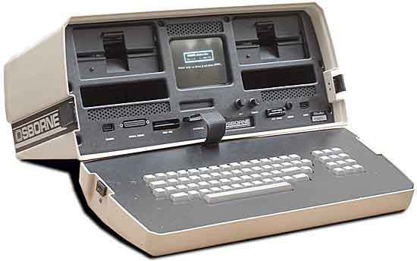


Value of Tenacity
CP/M vs. DOS
DAVID
^{Systems}
$8.80
Eventual lackluster IPO
Zero to $1.5B revenue; $4.2B Market Cap
2

Slide 39
Key Attributes of Value Creation
Brilliant and complementary team: vision to execution
Sustainably differentiated solution solving a big and fundamental problem
Optimistic Founder CEO who’s a great fundraiser
Not looking backward or too far ahead
Neurotic focus and effort
Enough self esteem to pivot and re-vector the business
Being willing to walk through walls
3

Slide 40



Pattern Recognition
Next generation network access solutions for the mobile enterprise
IPO in 2007
Fiscal 2014 revenues of $729M
Network performance leader
IPO in 2006 (#1 of the year)
2013 revenues of $1.04B
Agriculture analytics leader
Leveraging data science to $3T market
Monsanto acquires Climate for $930M
4

Slide 41
Early-Stage Funding Biases
First tier venture firms that can provide real venture assistance
“Feeding frenzy” with each round
Meaningful step-ups with outside venture firm setting price
Pro rata participation by all professional money
No selling shareholders
Venture debt
5

Slide 42

Financial Planning Guidance
Aspirational
Realistic
Transparent
Competent
6

Slide 43
Financial Planning – Key Decisions
Opportunity curve
Revenue chasing expenses or expenses chasing revenue:
Stage dependent
Cash and equity compensation levels – by stage
Dilution
7

Slide 44
Financial Planning – Key Decisions
Assumptions
Outcomes
Real Market Opportunity
Competitive Analysis
Market Share
Pricing
Volume Ramp
Monetization Model
SaaS
License
Services
Product Ship
Customer Acquisition &
Go-to-Market Model
Online
Channel
Direct
Partner
Homologation and Internationalization
Top- Line
90/10
8

Slide 45
Financial Planning – Key Decisions
Assumptions
Outcomes
Services Staff
Datacenter
Raw Material
Labor
Mfg Overhead, incl. Warranty
Manufacturer’s Profit
COGS
9

Slide 46
Financial Planning – Key Decisions
Assumptions
Outcomes
Sales Compensation
Sales Coverage
Levels
Inside/Outside
Team Model
Marketing Model
Demand Gen Methods
Sales/Channel Training
Development Model
Direct
Off-shore
ODM
R&D Team Strength
G&A Resources
Finance
Sales Ops
Legal
HR
Opex
10

Slide 47
Financial Planning – Key Decisions
Assumptions
Outcomes
IT Infrastructure
Datacenter
Facilities
Lab Equipment
Tooling
Capex
11

Slide 48
Financial Planning – Key Decisions
Assumptions
Outcomes
Detailed Product /
Solution Roadmap
Revenue
By Product Line
By Channel
By Geography
Sales Productivity
COGS Schedules
Income Statement
Rev/
Inc.
12

Slide 49
Financial Planning – Key Decisions
Assumptions
Outcomes
Cash Flow, incl. Funding Type/Levels and Timing
Capital Expenditure Schedule
Headcount Schedule
Balance Sheet
Base/Upside/Downside Cases
Capitalization Table
13

Slide 50
Building a Board
Strategist – Venture partner or otherwise
Trends
Vision
Drivers
Bona fide operating experience/mix
Product strategy
Go-to-market
Geographic
Industry-specific
Ops / financial
Relationship / Network
Customer contacts
Strategic partners
Regulatory / government
14

Slide 51
Building a Board- Continued
Actual attendance and participation – capacity
Prior board experience
No more than two employee members
Collegiality without cronyism
Diversity
15

Slide 52
Announcements
Assignment 4 due Monday 10/20 11:59PM
Unit Economics
Submit to msande273@gmail.com
Special Session: CFO’s are required to go! Financial modeling Deep Dive 10/16 5:30pm Nano 232.
Upcoming classes: Rahul Sharma & Mike Preiner (product dev)

